Slide 1

REVENUE INSIGHTS
MUSTAFA - THE DATA ANALYST

Slide 2


PROBLEM STATEMENT
AtliQ Grands owns multiple five-star hotels across India. They have been in the hospitality industry for the past 20 years. Due to strategic moves from other competitors and ineffective decision-making in management, AtliQ Grands is losing its market share and revenue in the luxury/business hotels category. As a strategic move, the managing director of AtliQ Grands wanted to incorporate “Business and Data Intelligence” to regain their market share and revenue. However, they do not have an in-house data analytics team to provide them with these insights.
Their revenue management team had decided to hire a 3rd party service provider to provide them with insights from their historical data.

Slide 3
TASK
Create the metrics according to the metric list.
Create a dashboard according to the mock-up provided by stakeholders.
Create relevant insights that are not provided in the metric list/mock-up dashboard.

Slide 4
ABBREVIATION

Slide 5
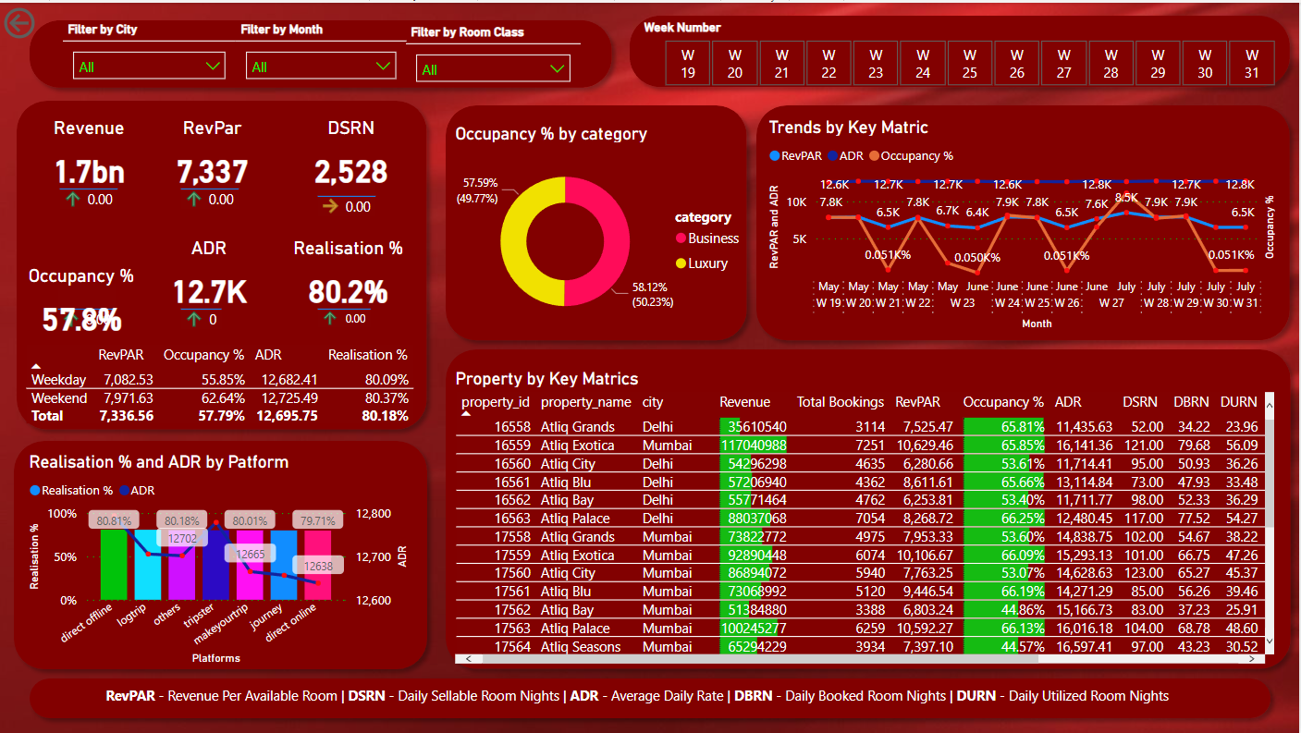
DASHBOARD

Slide 6
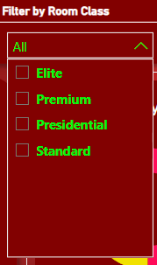
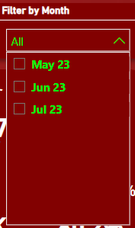
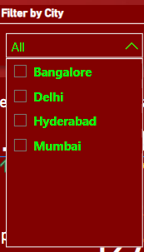
FILTER BY CITY/MONTH/ROOM CLASS

Slide 7
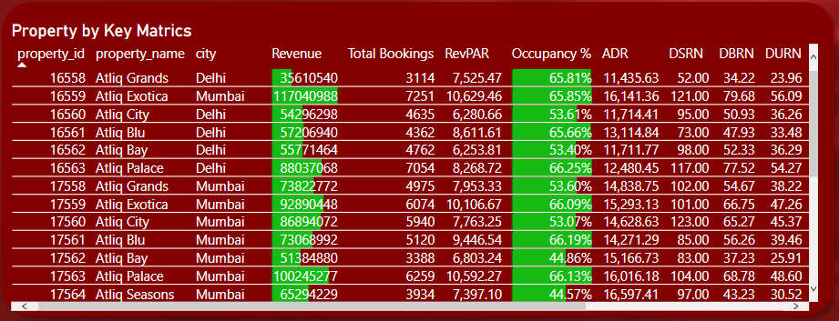
PROPERTY BY KEY MATRICS

Slide 8
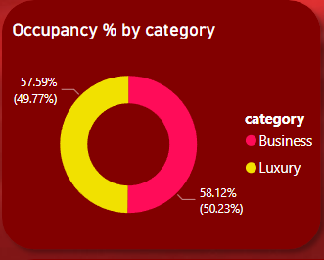
OCCUPANCY % BY CATEGORY

Slide 9

FILTER BY WEEK NUMBER

Slide 10
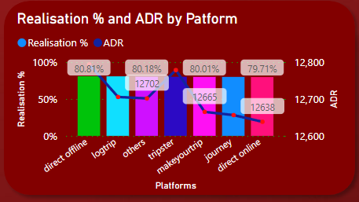
REALISATION % & ADR BY PLATFORM

Slide 11
THANK YOU
Email: canabisradarforbusiness@gmail.com
Phone(Whatsapp):+923494624108
Linkedin: www.linkedin.com/in/mustafatheanalyst/

